Slide 1
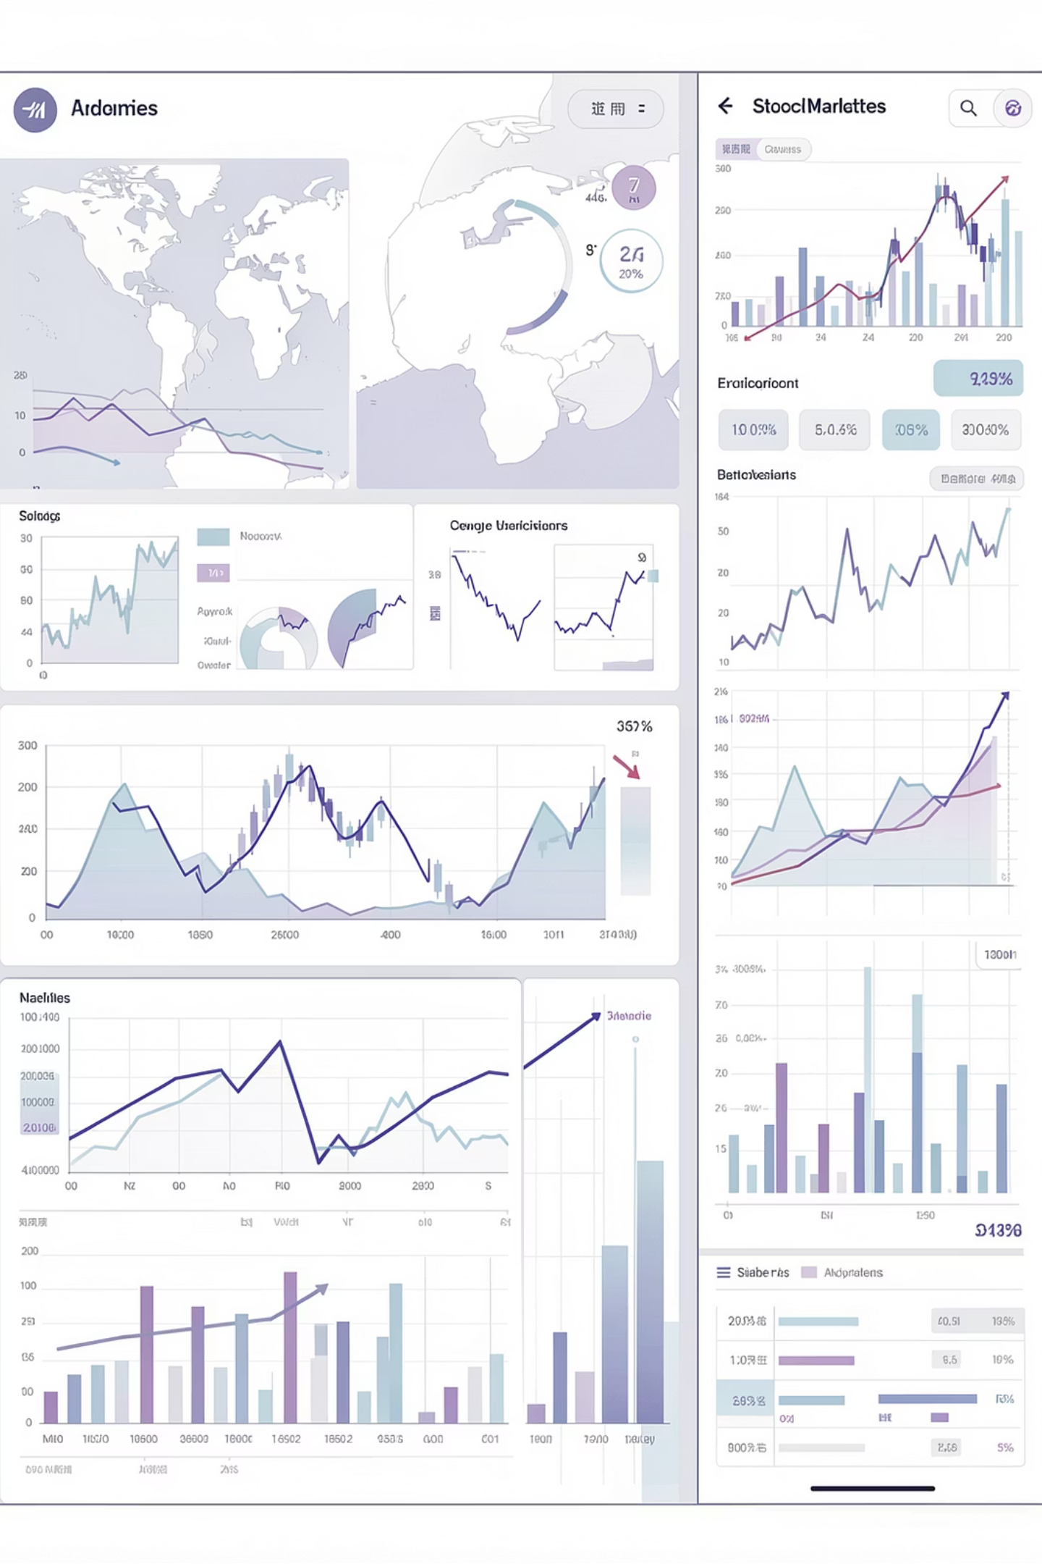
Global Stock Data Analysis: 2020-2024
This project analyzes daily global stock market indicators from 2020 to 2024 to understand market performance, volatility, and regional differences across major stock indices.

Slide 2
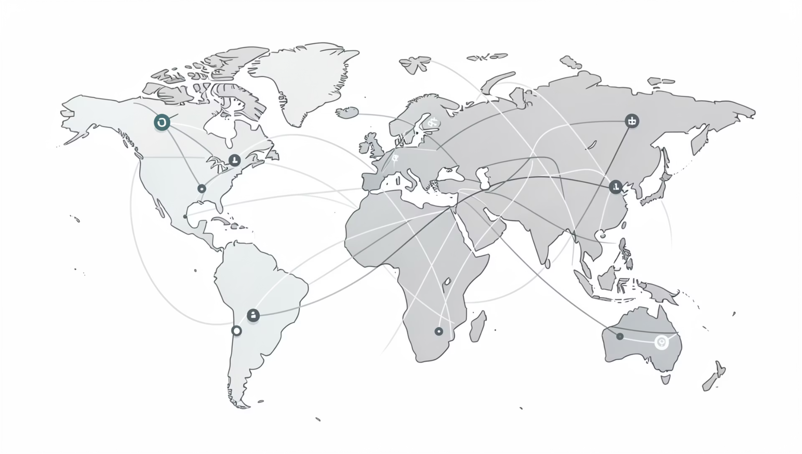
Project Overview & Objectives
Our objective is to generate data-driven insights that support investment analysis, risk assessment, and market comparison.
We utilized Python, SQL, and Power BI for comprehensive analysis.

Slide 3
Dataset Summary
1
2
Data Volume
Time Period
18,270 rows, 16 columns.
2020 – 2024.
3
4
Markets Covered
Key Attributes
S&P 500, NASDAQ, FTSE 100, Nikkei 225, Hang Seng, CAC 40, DAX, KSE 100, SSE Composite.
Date, market indicators (Open, High, Low, Close, Volume), Daily Change Percent, Region, Market Type.

Slide 4
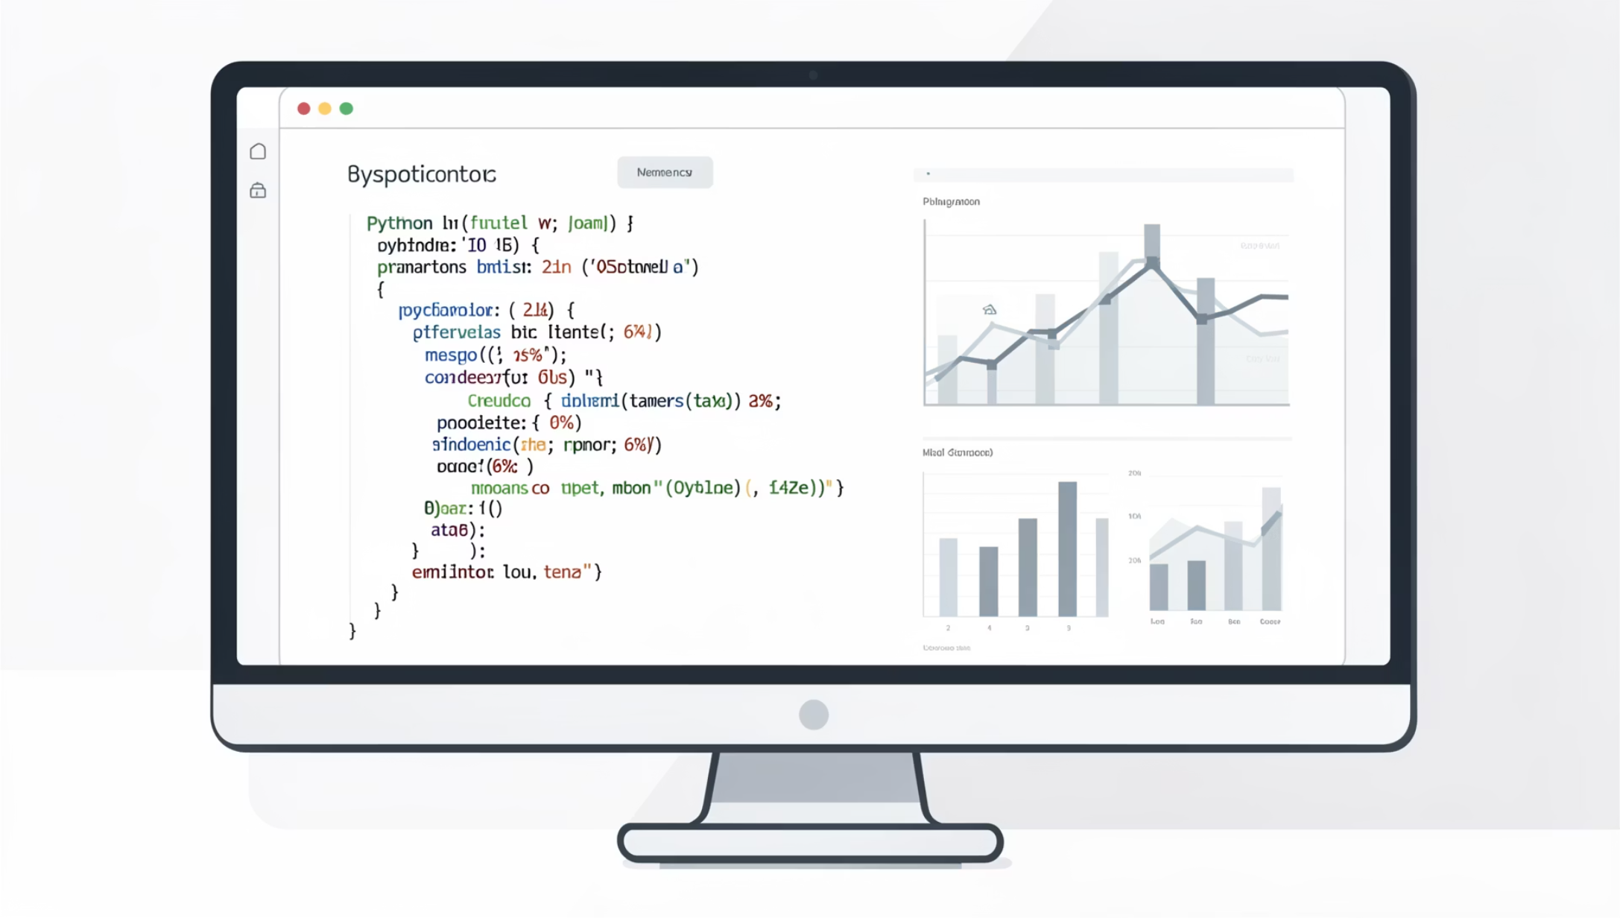
Exploratory Data Analysis (Python)
Data preparation and initial analysis were conducted using Python libraries like pandas, matplotlib, and seaborn.
Data Loading & Initial Exploration
Missing Data Handling
Feature Engineering (Year, Month, Quarter, Day of Week, Region, Market Type)
Database Integration (PostgreSQL)

Slide 5
Top 10 Worst Trading Days
Identified days with the largest overall negative market movements, highlighting major downturn periods.
2024-05-03
KSE 100
Pakistan
-44.32
627.90
33419892
2023-11-21
NASDAQ Composite
USA
-42.72
649.43
34849542
2023-02-07
CAC 40
France
-42.64
630.85
42793210
2020-05-24
S&P 500
USA
-42.15
671.16
36221540
2023-10-21
CAC 40
France
-42.11
622.95
3828348

Slide 6
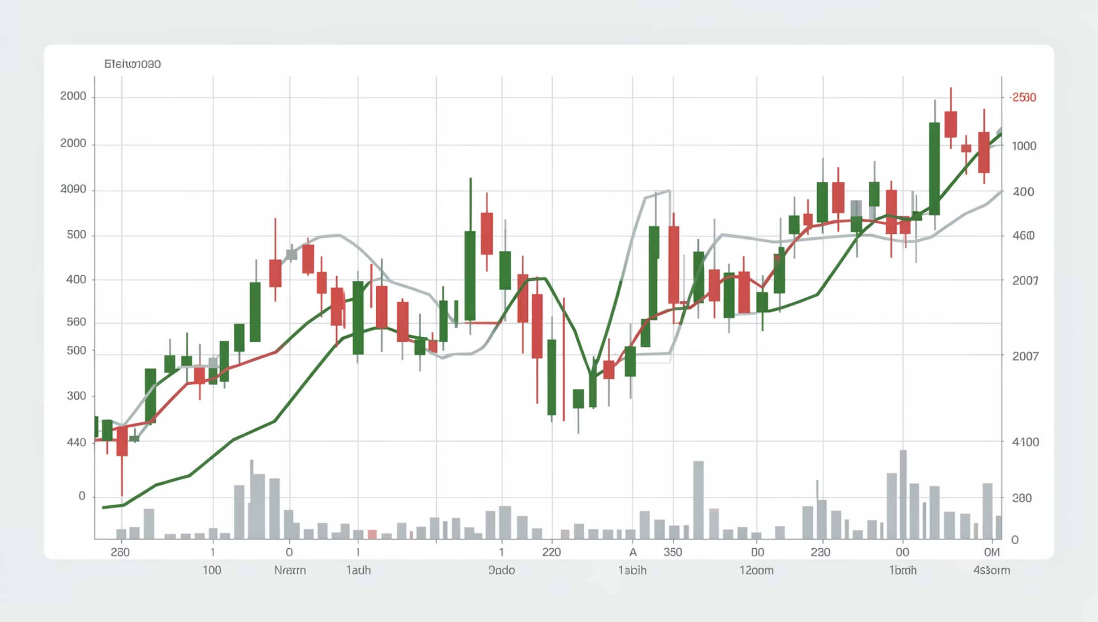
Market Volatility & Performance
Highest Volatility
FTSE 100 (4.84), Nikkei 225 (4.81), KSE 100 (4.78) show highest risk and instability.
Monthly Performance
March (0.210) and April (0.206) show highest average returns, while February (-0.113) and July (-0.164) are weakest.

Slide 7
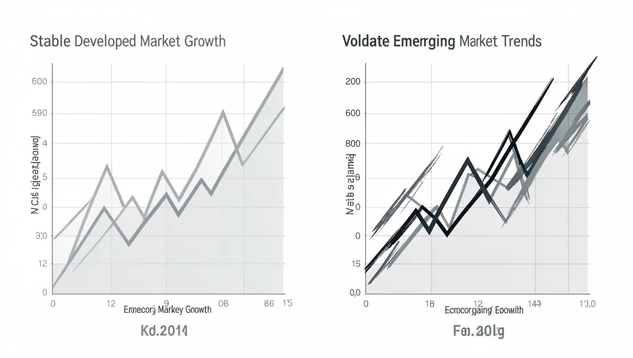
Developed vs. Emerging Markets
Emerging Markets
Higher average daily return (0.104) with slightly higher volatility (4.62).
Developed Markets
Lower average daily return (-0.018) but more stable with lower volatility (4.51).

Slide 8
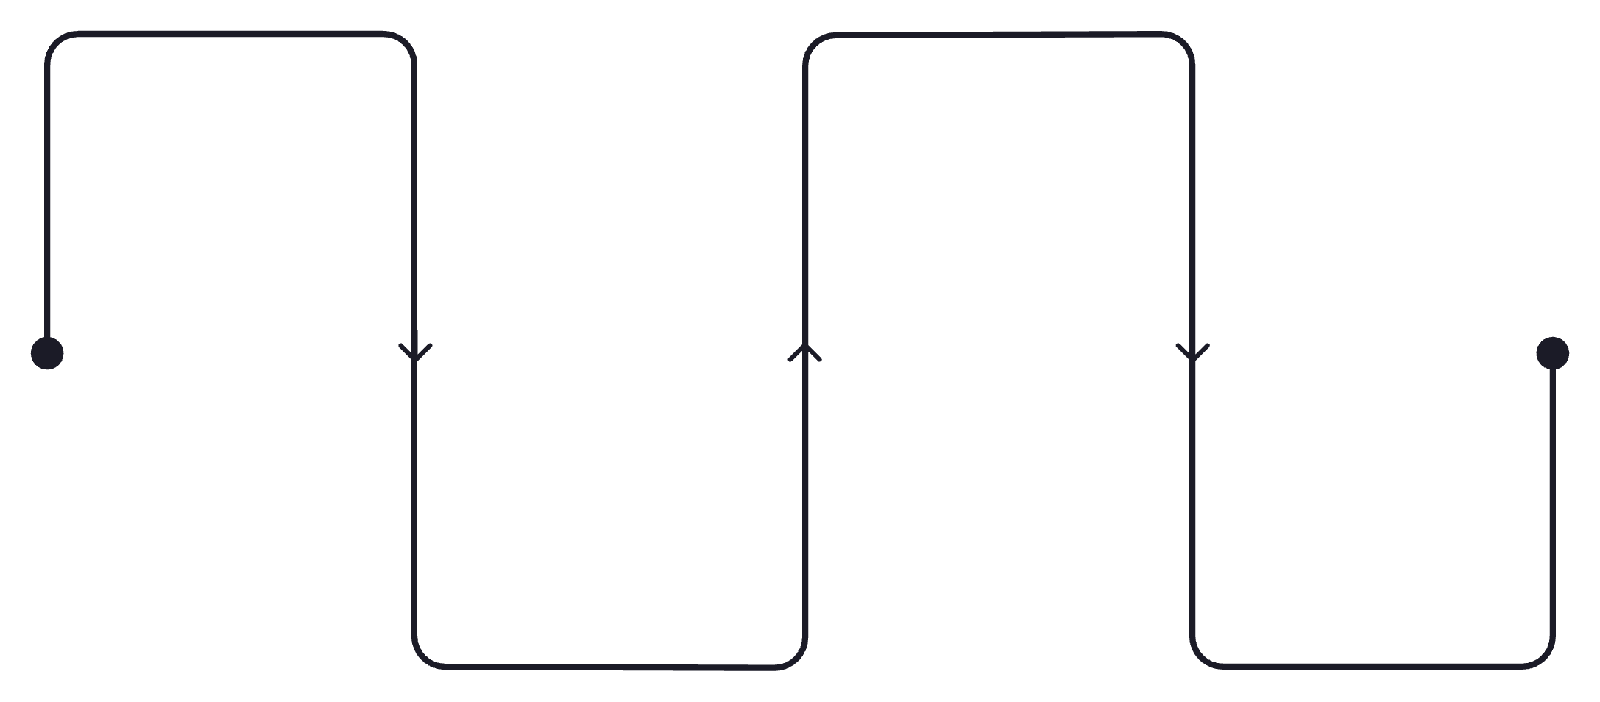
Quarterly & Day-of-Week Trends
Q1
Q3
Quarterly Performance
Average return: 0.045
Average return: 0.030
Q2 shows strong performance across Americas (0.099) and Emerging Markets (0.290).
Day-of-Week Patterns
Q2
Q4
Sunday (0.19) and Saturday (0.08) exhibit highest average returns, while Thursday (-0.16) is the lowest.
Average return: 0.099
Average return: 0.012
Quarterly trends reveal periodic growth and decline patterns, with Q2 often outperforming.

Slide 9
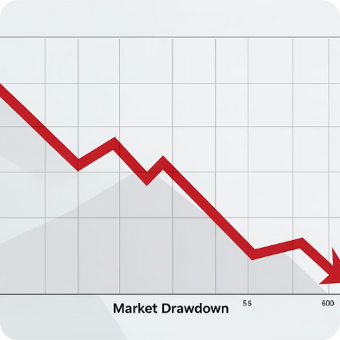
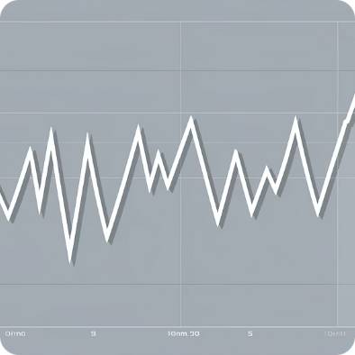
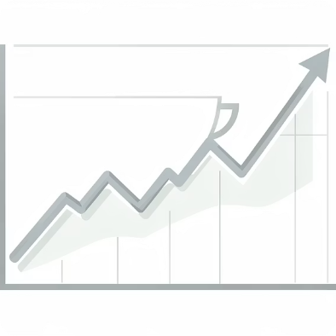
Risk Detection & High Performers
Market Drawdown
High Risk Periods
Consistently High Performing Markets
Nikkei 225 (14 days) and KSE 100 (13 days) experienced the longest loss streaks.
Dates like 2024-05-03 (18.97) and 2024-05-20 (16.14) show exceptionally high volatility.
KSE 100 (3 times), DAX (2 times), and FTSE 100 (2 times) frequently ranked in the top 3.

Slide 10
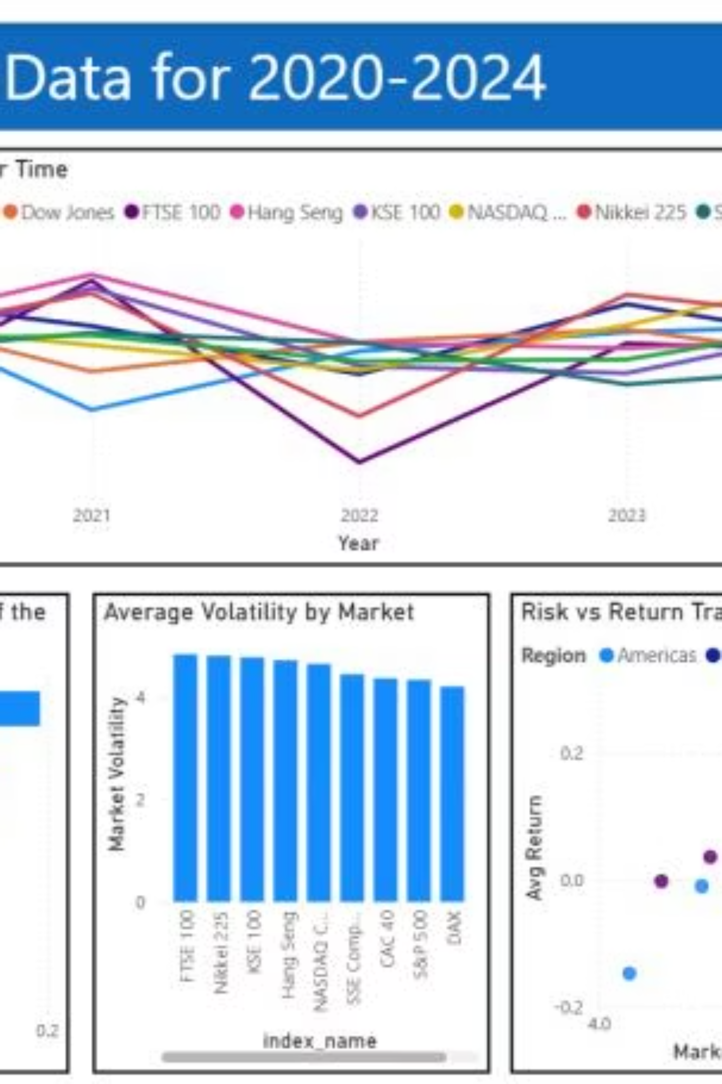
Key Insights & Recommendations
Market performance varied significantly, with higher volatility not always guaranteeing higher returns. Developed markets showed more stability.
Portfolio Diversification & Risk Management
Leverage Market Timing Strategies
Focus on Stable Markets & Regional Investment Planning

